Slide 1

Students will be able to converse well with effective speaking and listening skills in English.SRW SKILLS
LSRW- LISTENING, SPEAKING, READING, WRITING

Slide 2

After studying this unit you will know
Active Listening: Meaning and Art of Listening
Process and Types of Listening
Traits of a Good Listener, Ten Thumb Rules for Listening
Listening Techniques using Ted Talk Audio listening with script reading
Listening and Note taking
Pronunciation, Speaking Style & Content

Slide 3
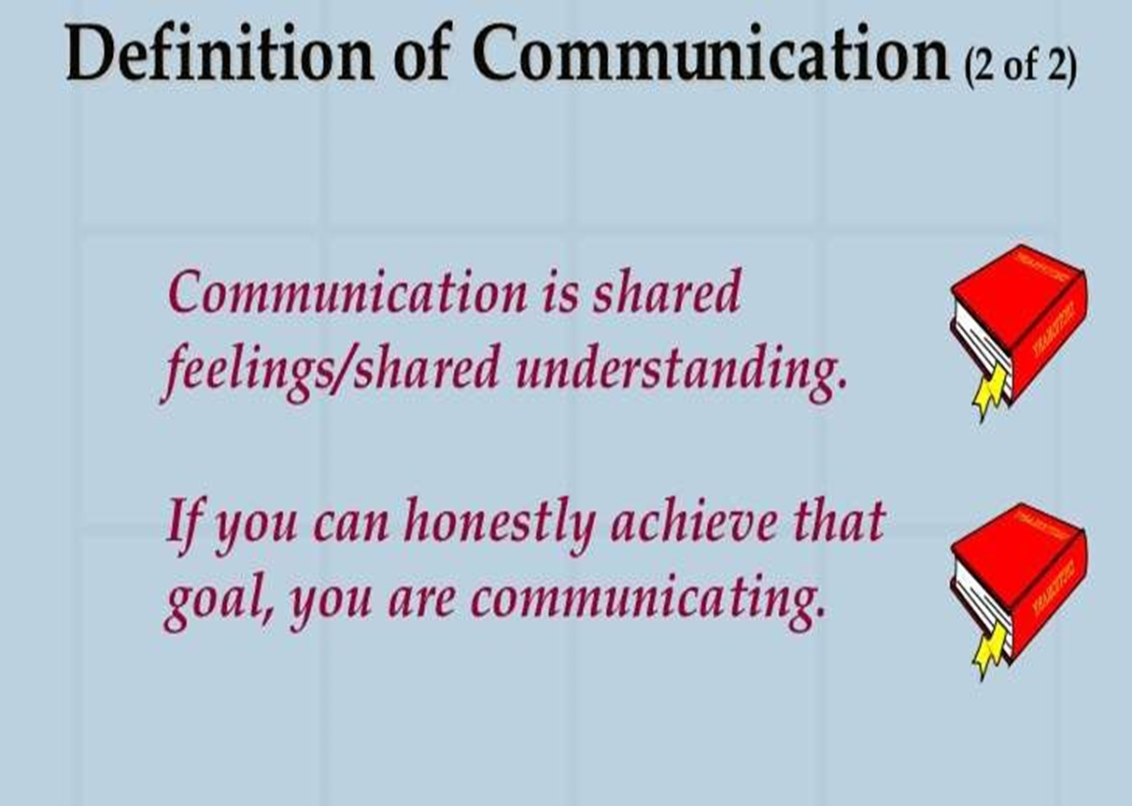
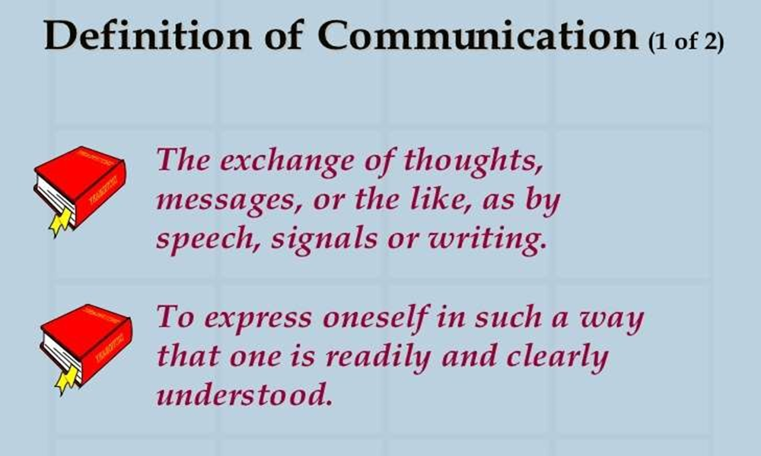
Communication

Slide 4
Components of Communication
Listening Skill
Speaking Skill
Reading Skill
Writing Skill

Slide 5
For communication process
one should recognize and understand the various sounds of a language
Then he/she should learn to discriminate between the different sounds
This is possible only if the learner gets an opportunity to listen speeches made by adults
Then only one can acquire the ability to speak
After speaking comes reading
Last of all comes writing

Slide 6
Communication Skills
The listening and reading skills are called Receptive Skills (Passive Skills)
While listening and reading the communicator is at the receiving end
Speaking and writing are called Productive Skills (Active Skills)
While speaking and writing the communicator is at the transmitting end

Slide 7
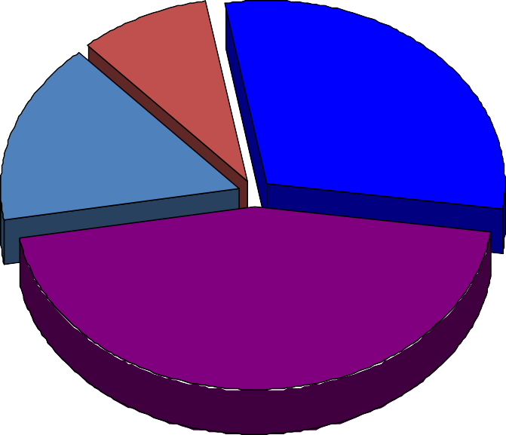
TOTAL COMMUNICATION PROCESS
Writing 9%
Speaking 30%
Reading 16%
Listening 45%

Slide 8

Active listening

Slide 9

Listening
Listening is the most important communication skill.
We probably spend more time using our Listening Skills than any other kind of skill
Real Listening is an active process
Listening requires attention

Slide 10
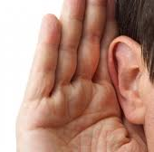
Effective listening
Effective Listening is the process of analyzing sounds, organizing them into recognizable patterns, interpreting the patterns and understanding the message by inferring the meaning.
Many of the problems we experience with people in our daily lives are primarily attributable to ineffective listening or lack of listening

Slide 11

Listening comes first
LISTENING
SPEAKING
READING
WRITING
11

Slide 12
Listening is not hearing
Listening and hearing are not the same. Hearing is the first stage of listening.
Hearing occurs when our ears pick up sound waves which are then transported to our brain.This stage is our sense of hearing.

Slide 13
Listening Skill
The skill of listening is the ability to receive and understand different speech sounds of a language
It is the training of one’s ears to understand and discriminate the meaningful messages communicated by the sounds of a language

Slide 14
Importance of listening
Communication is not complete without effective listening
An attentive listener stimulates better speaking by the speaker
A good listener learns more than an indifferent listener
A good listener can restructure vague speaking in a way that produces clearer meaning
A good listener learns to detect prejudices, assumptions and
attitudes

Slide 15

Active listening process
Hearing
Filtering
Comprehending
Remembering
Responding

Slide 16

HEARING
Hearing is the first essential step in the listening process
Relates to the sensory perception of sound.
For learning to be effective, hearing needs to be done with attentiveness and concentration.

Slide 17
FILTERING
Involves sensing and filtering of heard sounds.
The heard message is categorized as wanted or unwanted.
The unwanted message is discarded.
The sense of judgement of the individual comes into play, that is, the filtering process is subjective
A person chooses to retain what makes sense to him.

Slide 18
COMPREHENDING
The listener understands what the speaker has tried to convey
This activity can be described as absorbing, grasping or assimilating
The listener uses his knowledge, experience, perception and cognitive power.

Slide 19

REMEMBERING
The assimilated message is stored in memory to facilitate future recall.

Slide 20

RESPONDING
Responding to a message takes place at the end of the communication, immediately after or later, to show that the message is being received and comprehended.

Slide 21
TYPES OF LISTENING
Department of Applied Sciences & Humanities
ABES Engineering College, Ghaziabad

Slide 22
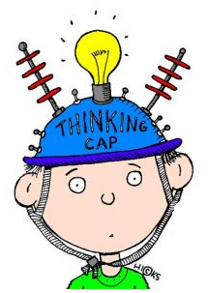




Informative Listening
Appreciative Listening
Comprehensive
Listening
Types Of Listening
Empathetic Listening
Critical Listening

Slide 23
Types of Listening
Appreciative Listening- this for deriving aesthetic pleasure, Listening for fun—to laugh, cry, use your imagination, or extend your creativity as we do when we listen to a comedian, musician or entertainer.
Empathetic Listening- we provide emotional and moral support in the form of it. You try to put yourself in another person’s place or see the world through his or her eyes e.g psychiatrists listening to their patients.

Slide 24
Comprehensive –listening to comprehend ideas and information in order to achieve a specific purpose or goal e.g., listen to lecture and Listening to announcements.
Critical Listening: Listening to understand, analyze, and evaluate messages so you can accept or reject a point of view, make a decision, or take action
when the purpose is to accept or reject the message or evaluate it critically. e.g listening to salesperson before making purchase or listening to politicians .

Slide 25
HOW TO IMPROVE LISTENING SKILLS
By: Dr. Seema Verma (Assistant Professor) Department of Applied Sciences & Humanities
ABES Engineering College, Ghaziabad

Slide 26
The 10 Principles of Listening
1. Stop Talking
“If we were supposed to talk more than we listen, we would have two tongues and one ear.” -Mark Twain.
Don't talk, listen. When somebody else is talking listen to what they are saying, do not interrupt, talk over them or finish their sentences for them. Stop, just listen. When the other person has finished talking you may need to clarify to ensure you have received their message accurately
2. Prepare Yourself to Listen
Relax. Focus on the speaker. Put other things out of mind. The human mind is easily distracted by other thoughts – what’s for lunch, what time do I need to leave to catch my train, is it going to rain – try to put other thoughts out of mind and concentrate on the messages that are being Communicated

Slide 27
The 10 Principles of Listening
3. Put the Speaker at Ease : Help the speaker to feel free to speak. Remember their needs and concerns. Nod or use other gestures or words to encourage them to continue. Maintain eye contact but don’t stare – show you are listening and understanding what is being said.
4. Remove Distractions :Focus on what is being said: don’t doodle, shuffle papers, look out the window, and pick your fingernails or similar. Avoid unnecessary interruptions. These behaviours disrupt the listening process and send messages to the speaker that you are bored or distracted.

Slide 28
The 10 Principles of Listening
5. Empathise : Try to understand the other person’s point of view. Look at issues from their perspective. Let go of preconceived ideas. By having an open mind we can more fully empathise with the speaker. If the speaker says something that you disagree with then wait and construct an argument to counter what is said but keep an open mind to the views and opinions of others.
6. Be Patient : A pause, even a long pause, does not necessarily mean that the speaker has finished. Be patient and let the speaker continue in their own time, sometimes it takes time to formulate what to say and how to say it. Never interrupt or finish a sentence for someone.

Slide 29
The 10 Principles of Listening
7. Avoid Personal Prejudice: Try to be impartial. Don't become irritated and don't let the person’s habits or mannerisms distract you from what they are really saying. Everybody has a different way of speaking – some people are for example more nervous or shy than others, some have regional accents or make excessive arm movements, some people like to pace whilst talking - others like to sit still. Focus on what is being said and try to ignore styles of delivery.
8. Listen to the Tone :Volume and tone both add to what someone is saying. A good speaker will use both volume and tone to their advantage to keep an audience attentive; everybody will use pitch, tone and volume of voice in certain situations – let these help you to understand the emphasis of what is being said

Slide 30
The 10 Principles of Listening
9. Listen for Ideas – Not Just Words :You need to get the whole picture, not just isolated bits and pieces. Maybe one of the most difficult aspects of listening is the ability to link together pieces of information to reveal the ideas of others. With proper concentration, letting go of distractions, and focus this becomes easier.
10. Wait and Watch for Non-Verbal Communication :Gestures, facial expressions, and eye-movements can all be important. We don’t just listen with our ears but also with our eyes – watch and pick up the additional information being transmitted via non-verbal communication. Do not jump to conclusions about what you see and hear. You should always seek clarification to ensure that your understanding is correct.

Slide 31
Difference between hearing and LISTENING
LISTENING
Listening means to interpret the noise, understanding it and provide an adequate response to it.
Listening is a conscious choice that demands your attention and concentration.
Listening is a skill that can be learned.
HEARING
Hearing only refers to your ears picking up noise.
Hearing is a passive occurrence that requires no effort.
Hearing is a physical ability.

Slide 32
Hearing is considered to be a biological phenomenon.
In hearing, after the brain receives the nerve impulses it may or may not sends feedback.
Listening is biological as well as psychological process.
In listening , after the brain receives the nerve impulses and deciphers it ,it then sends feedback.

Slide 33
Basis of Distinction | Active Listening | Passive Listening
Definition | Active listening means mindful and actively hearing and attempting to comprehend the meaning of the speakers. | Passive listening means showing like listening to the speaker but not making an attempt to comprehend the meanings.
Connectivity Level | Listener connects with the world and actively participates with the goal of problem-solving | Listener disconnects himself from the outsiders and has minimal interaction with others
Self-Responsibility | Take responsibility for their own learning and growth | Avoids responsibility for learning and problem-solving
Mental Approach | Sharp mind, alert to explore, reflect on the information | Accepts and retain information as-is with no intention to question or challenge the idea for improvement
Self-Motivation Level | Strong | Weak
Engagement Level | High | Low
Will-Power | Strong-willed, interested in new ideas, open-minded | Narrow-minded, low or no will power, unreceptive to new ideas

Slide 34
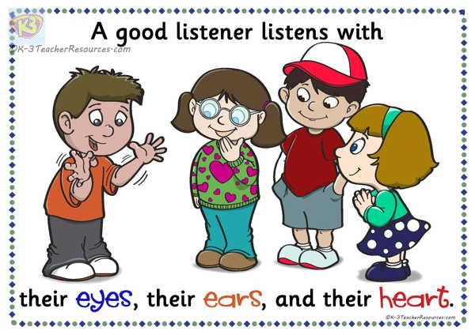
Traits of a good listener
Ten Traits of a Good Listener
They-
Hear you out – free of judgment.
See both sides of the story.
Know when to step in.
Put themselves at speaker’s place
Follow up on their promises.
Give the speaker their undivided attention
Provide appropriate nonverbal communication
Pace the conversation
Recall previous information

Slide 35
Effective Listening & Note-Taking
One way to enhance listening
Using a systematic approach to the taking and reviewing of your notes
Add immeasurably to your understanding and remembering of the content of lectures as a permanent record of key information
helps you distinguish where your ideas came from and how and what you think about those ideas.

Slide 36
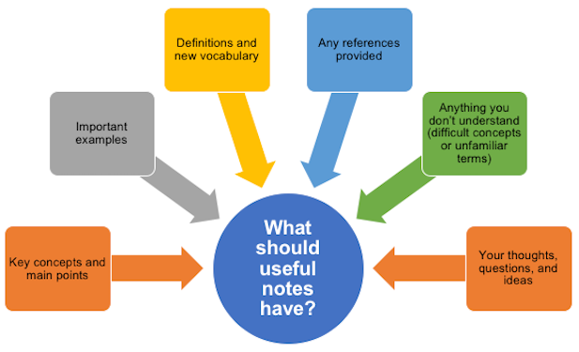
Effective Listening & Note-taking

Slide 37

Six good reasons to take notes
Notes are a useful record of key information, and the sources of that information.
Writing notes helps you remember what you heard.
Taking notes helps you to concentrate and listen effectively.
Selecting what to note down increases your understanding.
Notes create a resource for exam preparation.
Notes taken in classes often contain information that can’t be found elsewhere.

Slide 38

Before Class
Develop a mind-set geared toward listening.
Test yourself over the previous lecture while waiting for the next one to begin.
Read assigned material (SQ3R) or at least S (skim) and Q (question) to acquaint yourself with main ideas, new terms, etc. (Reduce, Recite and Reflect)
Do what you can to improve physical and mental alertness
Choose notebooks that will enhance your systematic note-taking(Cornell System of Note-taking)
Intend to listen.

Slide 39

During Class
Listen for the structure and information in the lecture. Use signal words such as:
“Today I want to cover...” Introduction and/or Title
“Four points...” “Three causes...” Organizational cues
“Next I want to discuss...” Change of topic
“I emphasize...” “To repeat...” Cues regarding importance
Pay attention to the speaker for verbal (louder or higher pitched inflections) and body language cues of what’s important.
Be consistent in your use of form, abbreviations, etc. (key your abbreviations).

Slide 40
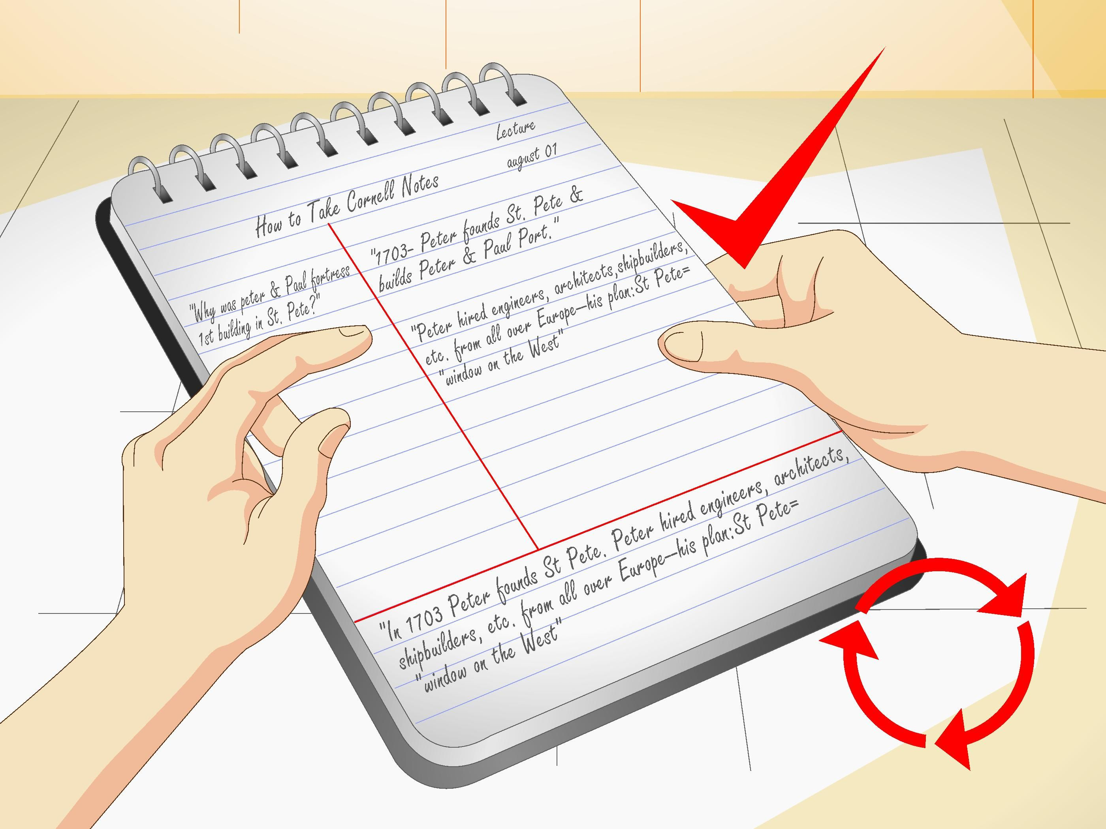
During Class
Make a conscious effort to concentrate on what the speaker is saying
Label important points and organizational clues: main points, examples.
Ask questions if you don’t understand.
Instead of closing your notebook early and getting ready to leave, listen carefully to information given toward the end of class.

Slide 41
After Class: SAME DAY AS LECTURE (Reduce, Recite, Reflect)
Clear up any questions raised in the lecture by asking either the teacher or classmates.
Fill in missing points or misunderstood terms from text or other sources.
Edit your notes, labelling main points, adding recall clues and questions to be answered. Key points in the notes can be highlighted with different colours of ink.
Make note of your ideas and reflections, keeping them separate from those of the speaker.

Slide 42
After The Class
A checklist for editing your notes:
Did you state the main topic of the lecture?
Are all words intelligible?
Are symbols and abbreviations keyed?
Is the structure clear? If not, you may need to rewrite.
Did you write cue words in the left margin for self-testing?
Did you miss any points? You may need to compare notes with a classmate.

Slide 43
After The Class
Periodically (Review)
Review your notes: glance at your recall clues and see how much you can remember before rereading the notes.
Look for the emergence of themes, main concepts, methods of presentation over the course of several lectures.
Make up and answer possible test questions.

Slide 44
BOOKS PRESCRIBED
Technical Communication, (Second Ed.); O.U.P., Meenakshi Raman & S.Sharma New Delhi,
2011.
2. Business Communication for Managers, Payal Mehra, Pearson, Delhi, 2012.
3. Personality Development, Harold R. Wallace et. al, Cengage Learning India Pvt. Ltd; New Delhi
2006.
4. Practical Communication by L.U.B. Pandey; A.I.T.B.S. Publications India Ltd.; Krishan Nagar,
Delhi 2013.
5. Personality Development & Soft Skills, Barun K.Mitra, Oxford University Press, New Delhi, 2012.

Slide 45

Speaking Skills

Slide 46
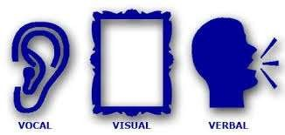
W h a t A r e S p e a k I n g s K I L L S?
7%
Verbal
(words spoken)
38%
Vocal
(tone, range, appeal, credibility of voice)
Visual
(physical appearance, gestures, eye contact)
55%

Slide 47
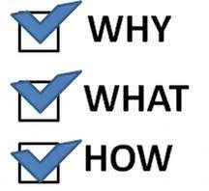
Speaking consist of 3parts
To Speak
To Speak.
To Speak

Slide 48
Speaking skill
Speaking skill is the art of communication (productive skill)
Good speaking skills is the act of generating words that can be understood by listeners.
A good speaker is clear and informative.

Slide 49
Elements of good speaking
Articulation
Pronunciation
Voice quality
Accent
Intonation
Pause
Punctuation

Slide 50
Guidelines for speaking
Speed
Clarity
Punctuation
Pronunciation
Familiarity
Fluency
Expressions

Slide 51
The speaking skill
A person who can speak English can:
Produce the characteristic English speech sounds and sound patterns both in isolation and combination.
Use appropriate stress and intonation patterns.
Use appropriate words and structures to express the intended meanings.
Recall words and structures.
Organize thoughts and ideas into logical sequence.
Adjust speech according to audience.

Slide 52

Stress
Stress is the degree of force with which a syllable or a word is uttered.
It is also defined as the degree of prominence a syllable has.
Words with more than one syllables have a stressed syllable. In /teibl/ first syllable is prominent.
In committee and recommend second syllable is stressed.

Slide 53
What is Word Stress?
In English, we do not say each syllable with the same force or strength. In one word, we accentuate ONE syllable. We say one syllable very loudly (big, strong, important) and all the other syllables very quietly.

Slide 54

Activity
Let's take 3 words: photograph, photographer and photographic
Do they sound the same when spoken?

Slide 55
No. Because we accentuate (stress) ONE syllable in each word. And it is not always the same syllable. So, the shape of each word is different.

Slide 56
•
PHO TO GRAPH
3
#1
PHO TO GRAPHER
4
#2
PHO TO GRAPH IC
4
#3

Slide 57
Rules for word stress
One word, one stress. (One word cannot have two stresses. So, if you hear two stresses, you have heard two words, not one w word.)
The stress is always on a vowel.

Slide 58

Why stress is crucial in English
Stress is crucial in English pronunciation. It can be called a grammatical device in English.
A part of the meanings of a word depends on stress. it serves to mark the function of words in spoken English.

Slide 59
Levels of stress
1-primary level
2-secondary level
3-tertiary level (unnecessary degree of complexity)

Slide 60
Types of stress
1-word stress :It shows that what syllable in a word is stressed e.g. useful, is stressed on the first syllable, advantageous has a primary stress on first and secondary stress on third syllable.
2-Sentence stress: It shows what words in a sentence are stressed

Slide 61
TONGUE TWISTERS
A phrase that is designed to be
difficult to say…

Slide 62
INTRODUCTION
Listening and trying to say tongue twisters is one way to improve your English pronunciation. They are fun to try and are a challenge for anyone! So don't worry if you make mistakes. Just have fun!

Slide 63

Betty Botter bought a bit of butter. The butter Betty Botter bought was a bit bitter And made her batter bitter. But a bit of better butter makes better batter. So Betty Botter bought a bit of better butter Making Betty Botter's bitter batter better

Slide 64

How much wood would a woodchuck chuck if a woodchuck could chuck wood? He would chuck, he would, as much as he could, and chuck as much wood as a woodchuck would if a woodchuck could chuck wood.

Slide 65

A Flea and a Fly A flea and a fly flew up in a flue. Said the flea, "Let us fly!" Said the fly, "Let us flee!" So they flew through a flaw in the flue.

Slide 66

A canner can can anything that he can, But a canner can’t open a can, can he?

Slide 67
If two witches were watching two watches, which witch would watch which watch?

Slide 68

The sixth sick sheik's sixth sheep's sick

Slide 69

A big bug bit a bold bald bear and the bold bald bear bled blood badly.

Slide 70
A mother to her son did utter "Go, my son, and shut the shutter" "The shutter's shut" the son did utter "I cannot shut it any shutter!

Slide 71
Peter Piper picked a peck of pickled peppers. A peck of pickled peppers Peter Piper picked. If Peter Piper picked a peck of pickled peppers, Where’s the peck of pickled peppers Peter Piper picked?

Slide 72
Theophilus Thadeus Thistledown, The successful thistlesifter, While sifting a sieve-full of unsifted thistles, Thrust three thousand thistles through the thick of his thumb. Now, if Theophilus Thadeus Thistledown, The successful thistlesifter, Thrust three thousand thistles through the thick of his thumb, See that thou, while sifting a sieve-full of unsifted thistles, Thrust not three thousand thistles through the thick of thy thumb.

Slide 73

Reading Skill

Slide 74

When do we use reading
To learn the script of a language •
To learn concepts of any topic in details •
To get entertained •
To get directions •
To understand instructions
In fact, Reading is the source of most of our information.

Slide 75

4 styles of reading a text
Depending on our purpose of reading, we adopt any of the four styles generally:
Skimming
• Scanning
• Churning
• Assimilating

Slide 76
Skimming
Fast browsing of the entire passage.
1
We get a rough idea about the topic of the passage
2
Humans have an inborn habit of trying to do things efficiently. They need to save time.
3
When we are searching for an information, and we have a large number of texts to choose from, we do a fast-browsing to decide which texts to read, and which to reject.
4

Slide 77

Scanning
Look for specific information in the text
It makes you “skip more than you read.”
Also called search reading

Slide 78
Churning
Churning means interpretation and inference.
Churning
v
Interpretation: Getting the summary of all the important points on a topic.
Inference: Reading between the lines. Understanding facts that are not stated openly.

Slide 79

Interpretation: How is it done?
Depending on the question, we need to decide what angle we are going to take, to interpret a text.
Generally, a text contains discussion on more than one keyword. You have to collect information on the specific keyword that is asked in the question.

Slide 80
Inference: How is it drawn?
In order to draw inference,
one has to apply one’s logic.
and try to connect the dots.

Slide 81

Techniques to do Churning
Churning Techniques = Understanding 2 things:
Word Meaning
Coherence

Slide 82
Techniques to do Churning
Churning Techniques = Understanding 2 things:
Word Meaning
✓Same word, Different meaning in 2 contexts ✓Unknown word, meaning guessed via context ✓Unknown word, guessed via root words ✓Reading sense-groups ✓Knowing the topic beforehand.
Coherence

Slide 83
Techniques to do Churning
Churning Techniques = Understanding 2 things:
Word Meaning
Coherence
Discourse Markers

Slide 84
Word Meanings
Understanding different meaning based on contexts.
Guess the unknown words from context.
Guess meaning from root words.
Read not the sentence, but sense-groups.
Try to get an overview beforehand.

Slide 85
Discourse Markers
• Discourse markers are words that come at the beginning of sentences, like ‘clearly’, ‘therefore’, ‘lastly’, ‘on the other hand’, ‘however’, etc.
They indicate whether the sentence is an example, a conclusion, or an opposite opinion.
They help us understand how an idea is developed in a passage.

Slide 86
Reading Style 4 : Assimilating
When we attempt to make a mental map of the entire passage that we have read, it is called assimilating.
When we say we have understood a concept after reading a chapter, we have actually done assimilation.

Slide 87
Steps to do Assimilation
Churning has made available the information. Convert the information into an idea. Think about it at a personal level.
Look for pictures, videos and other texts related to the topic to get better knowledge.
• Discuss with peers to get their view-points as well.
• This will help you plant a mental-map of the information you have read.

Slide 88
Writing
The act or art of forming letters and characters on paper, wood, stone, or other material, for the purpose of recording the ideas with characters and words express, or of communicating them to others by visible signs.

Slide 89
Why Written Communication?
Creates a permanent record
• Allows you to store information for future reference
• Easily distributed
• All recipients receive the same information
• Necessary for legal and binding documentation

Slide 90
Writing Skills?
The ability to write does not require a unique talent or an outstanding mental ability
Everyone has the basic skills necessary to write well
A basic understanding of writing and a commitment to writing well in all situations is needed as a professional Questions a writer ask.

Slide 91
Questions a writer asks
How do I begin?
• What is my purpose?
• How do I make my point clear?
• How do I create a logical flow?
• How do I say what I mean?
• How do I avoid grammatical errors?
• How can I make my message brief?
• How can I create a visual effect?

Slide 92











Three-Step Writing Process
Three-Step Writing Process
Step 1 Step 2 Step 3
Planning
Writing
Quality control

Slide 93
The Writing Process
Planning
Writing
Quality Control

Slide 94
The Writing Process
Planning
Keep objectives in mind and research the topic
Think about the audience
Outlining helps organize thoughts

Slide 95
The Writing Process
Writing
Follow your outline, use your handbook
Inspiration is acceptable but must be carefully reviewed
Use the interview approach to supplement the outline (who, what, where, when, how)

Slide 96
The Writing Process
Quality Control
Reread your work
Be critical of your own work

Slide 97
Considerations while writing
Who?
What?
When?
Why?
Where?
How?

Slide 98
Good Writing
Completeness: all information needed is provided
Correctness: relevant and precise information
Credibility: support your argument
Clarity: should not be vague, confusing, ambiguous
Conciseness: to the point
Consideration: anticipate the reader’s reaction
Vitality: use the active voice rather than the passive voice

Slide 99
Types of Writing
E-mails
Letters and Memos
Agendas
Reports
Promotional Material
Academic Documents
Research (scientific) manuscripts
White Papers

Slide 100
The Process of Writing
Prewriting
Publishing and Presenting
Drafting
Editing Proofreading
Revising

Slide 101
The Process of Writing
Prewriting is the stage in which you explore possible topics, choose a topic, and then gather details you can include in your writing.
Drafting involves putting ideas down on paper in a rough format.

Slide 102
Revising is the stage in which you rework your rough draft to improve both its form and its content.
Editing and proofreading are the stages in which you polish your writing, fixing errors in grammar, spelling, and mechanics.
Publishing and presenting are the sharing of your writing.

Slide 103
COMMON ETIQUETTES IN WRITTEN COMMUNICATION
While written communication affords greater flexibility, since it can be edited and both composed and read at leisure or at one's pace, a great deal of care needs to be taken, in order to ensure its effectiveness; as it can serve as a point of reference, which one can turn to time and again, thus creating a more lasting impact.

Slide 104
FOCUS ON FORMAT
The various formal writing forms have a pre- determined, universally accepted format that accompanies them. This format, which is largely based on universal writing conventions, serves to facilitate communication, by eliminating miscommunication that may result through random writing styles.

Slide 105
Moreover, these formats are likely to change with time, due to the evolving nature of communication and/or technology.
For example, the semi block format that was earlier the most relied upon format for letter writing has now given way to the full block format, after the wide spread use of computers.

Slide 106
2. STUCTURING OF THE CONTENT
Introduction, Body and Conclusion: While writing one should ensure that the content is well organized, with the overview/basic details comprising the introduction; all major points with their explanation and exemplification constituting the body (preferably divided into a separate paragraph each for every new point, with titles and subtitles, if necessary).

Slide 107
3. ENSURING CONNECTIVITY
The content that comprises a piece of writing should reflect fluency and should be connected through a logical flow of thought, in order to prevent misinterpretation and catch the attention of the reader.
Moreover, care should be taken to ensure that the flow is not brought about through a forced/deliberate use of connectives , as this make the piece extremely uninteresting and artificial.

Slide 108
4. TEMPERING THE CONTENT AS PER THE LEVEL OF FORMALITY
The level of formality that is shared between the sender and receiver should define the use of salutations, the vocabulary, the content, the format and even the medium.
Though not integral to the matter communicated, this courtesy helps in creating a balanced impression about the communicator.

Slide 109
5. STEERING CLEAR OF SHORT FORM
People may not be aware of the meaning of various short forms and may thus find it difficult to interpret them. Moreover, short forms can at time be culture specific or even organization specific and may thus unnecessarily complicate the communication.

Slide 110
6. IMPORTANCE OF GRAMMER, SPELLING AND PUNCTUATION
Improper grammar can at worst cause miscommunication and at least result in unwanted humour and should be thus avoided. So too, spellings can create the same effect or can even reflect a careless attitude on part of the sender.
Finally, effective use of punctuations facilitates reading and interpretation and can in rare cases even prevent a completely different meaning, which can result in miscommunication.

Slide 111
7. SENSITIVITY TO THE AUDIANCE
One needs to be aware of and sensitive to the emotions, need and nature of the audience in choosing the vocabulary, content, illustrations, formats and medium of communication, as a discomfort in the audience would hamper rather than facilitate communication.

Slide 112
8. IMPORTANCE OF CREATIVITY
In order to hold the readers' attention one needs to be creative to break the tedium of writing and prevent monotony from creeping in.
This is especially true in the case of all detailed writing that seeks to hold the readers' attention.

Slide 113
9. AVOIDING EXCESSIVE USE OF JARGON
Excessive use of jargon can put off a reader, who may not read further, as, unlike a captive audience, the choice of whether to participate in the communication rests considerably with the reader.

Slide 114
10. AWARENESS OF THE AUDIENCE/MEDIUM
The medium needs to be chosen, as per its suitability to the audience/content; while the content would need tempering as per the medium/audience. For example, while an elaborate message can be sent via a letter or an email, an sms, the same content may have to be heavily edited.
Like all effective communication, good writing could be said to occur when the gap between 'what one desires to say and what one is constrained to mean' is negligible or almost non- existent.

Slide 115
DIFFERENT WRITING STYLES
There are three types of writing styles:
Colloquial
Casual
Formal

Slide 116
COLLOQUIAL
Colloquial language is an informal, conversational style of writing. It differs from standard English in that it often makes use of colourful expressions, slang, and regional phrases. As a result, it can be difficult to understand for an a person from a different region or country.

Slide 117
CASUAL
Casual language involves everyday words and expressions in a familiar group context, such as conversations with family or close friends. The emphasis is on the communication interaction itself, and less about the hierarchy, power, control, or social rank of the individuals communicating.

Slide 118
FORMAL
Formal language is communication that focuses on professional expression with attention to rules, protocol, and appearance. It is characterized by its vocabulary and the grammatical arrangement of words in a sentence. That is, writers using a formal style tend to use a more sophisticated vocabulary.

Slide 119
Which style you use will depend on your audience, and often whether your communication is going to be read only by those in your organization (internal communications) or by those outside the organization, (external communications).

Slide 120
SOME DO’s AND DON’TS
Be Specific: Just like a reporter, communicate
the “who, what, where, why, when and how” of what needs to done. Stay objective and specific.
Avoid the Passive Voice: Instead of writing “The program was planned by Dane,” write, “Dane planned the program.”
Be Concise :There’s no need to be long-winded. Get to the point. You’ll lose readers if you spout off too long!

Slide 121
Get Things Right :Take great care when spelling people’s names,, and other specifics. And also make sure that you do a careful proof of your work.
Know When Formal Language is Required: If you’re writing an informal note to group
members, it’s fine to use contractions (“don’t” instead of “do not”).However, if you’re writing for a formal audience, like a proposal to the board of directors, be more formal with your language.

Slide 122
Read It Out Loud :One very effective way to self-proof your work is to read it out loud. This will help you determine if you’ve used incorrect words, if your sentences run on too
long, if your tenses don’t match, and more.

Slide 123
CONCLUSION
Utilize full potential of written communication
What you write will ultimately define you as a professional to your colleagues and superiors
Match the appropriate communication method to the recipient
Eliminating excessive or unnecessary communication will improve your workflow
Mastering these skills will improve your ability and enhance your career.

Slide 124
THANK YOU.

